Slide 1
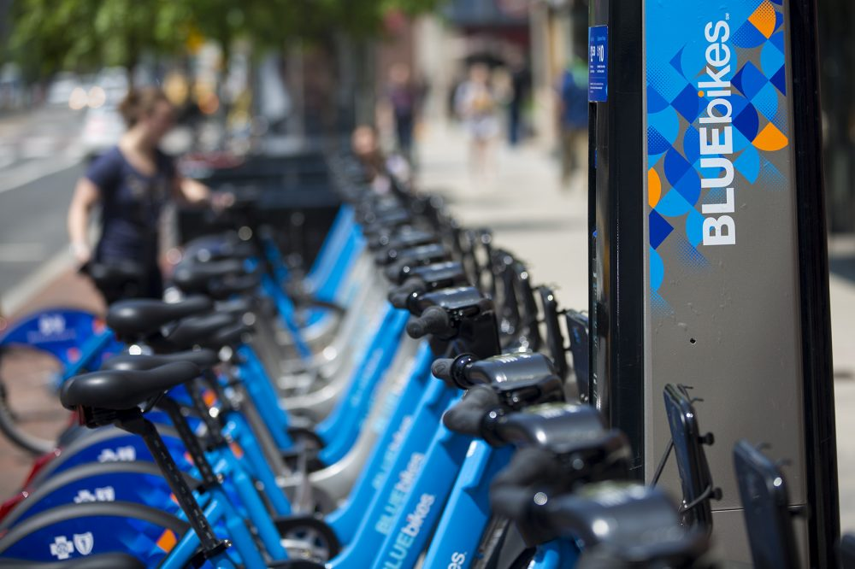
BLUEBIKES
MANAGEMENT
SYSTEM
GROUP 7:-
YASH NEMA- 001562522
MOHIT NAGPAL-001502719
SUSHMITA MAITY-001092534
NIRMAYEE DIGHE-002984202
ARJUN JANARDHAN-001566405
MAHENDRA KASWAN-002195119

Slide 2





OVERVIEW
Serves in Boston
Metropolitan Area
Fleet of 393 Bike Stations & 3800 Bikes
Easily available &
affordable pricing
Higher usage -–> higher inefficiency in ride booking & payments
Proposing a better & efficient RDBMS

Slide 3




PROBLEM STATEMENT
Persistent payment issues & slow loading of the application
Fare calculation w.r.t time duration, membership mode of membership & discount coupons
Providing membership options: Weekly pass, Monthly pass & annual pass
Ensuring data privacy, storage of past records, bike inventory & data accessibility w.r.t roles & requirements.

Slide 4
PROPOSED SOLUTION
Booking management: Setting up account, take a subscription, book a bike, call a customer care, making a payment
Customer Care management: Assign/ Pick tickets from queue
Employee management: Employee details log

Slide 5
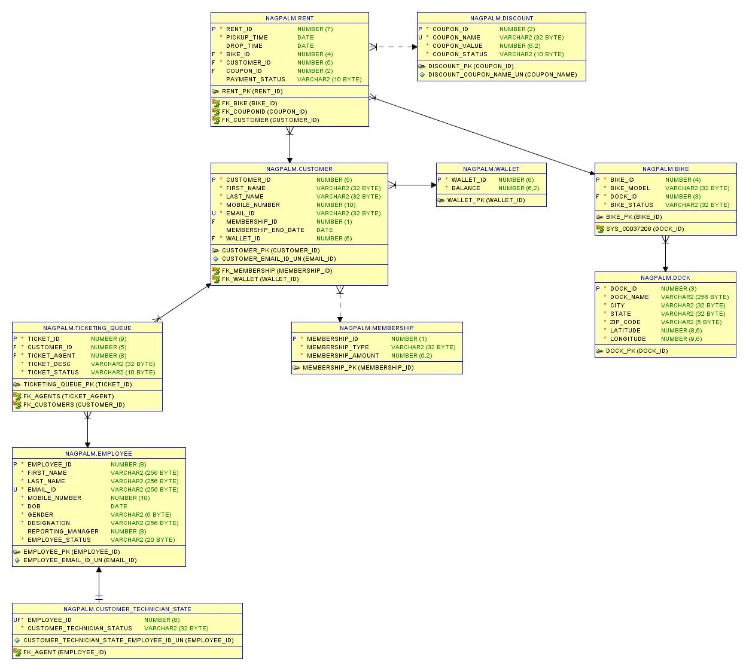
ERD

Slide 6
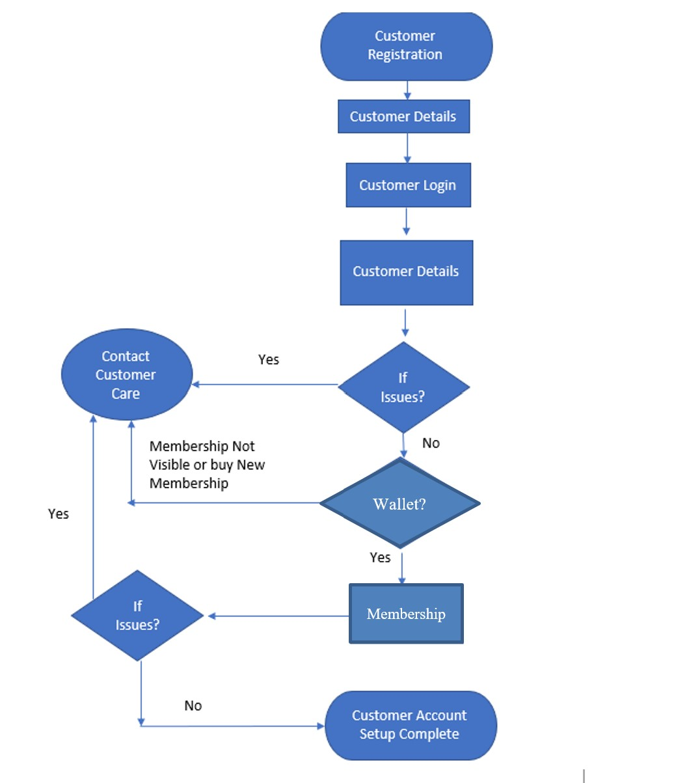
FLOW DIAGRAM - 1) Customer Registration

Slide 7
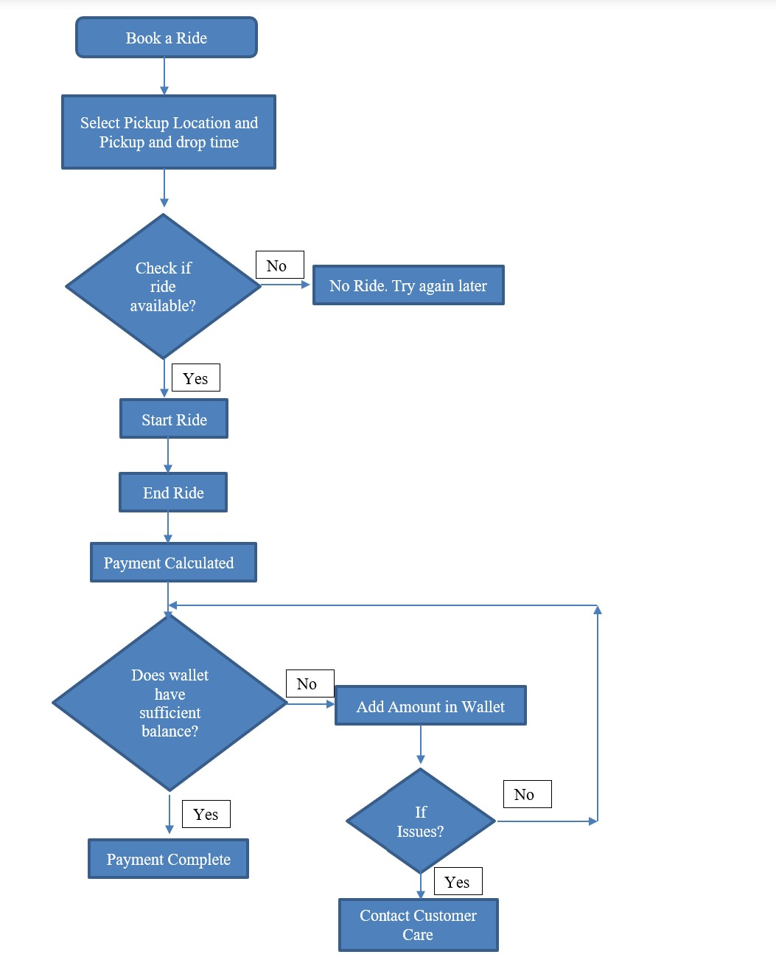
FLOW DIAGRAM - 2) Ride Booking

Slide 8
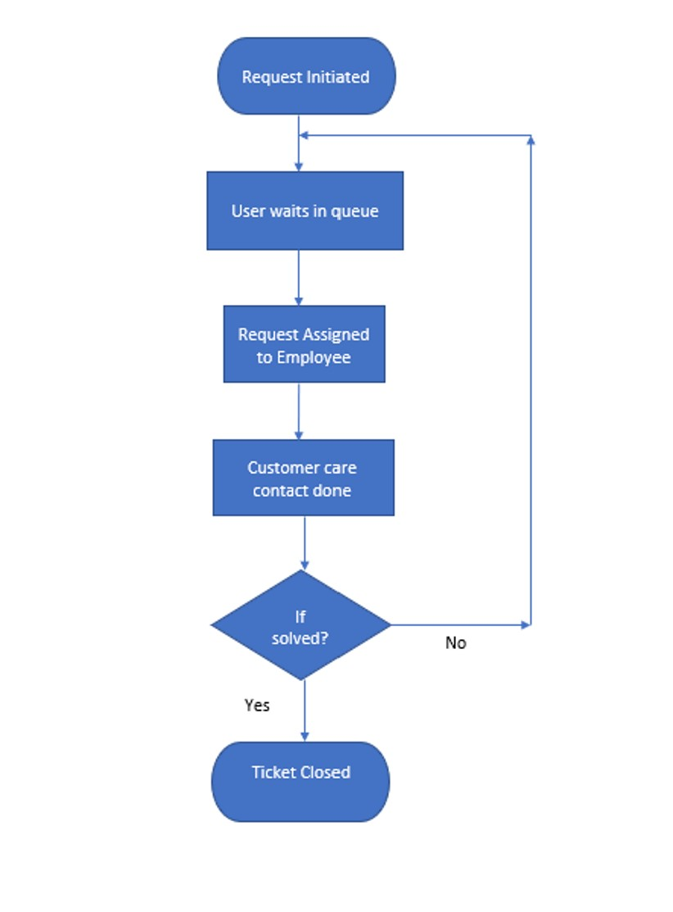
FLOW DIAGRAM - 3) Ticket Handling

Slide 9
Key Functions
Tables
Procedures
Packages
Indexes
Triggers
Functions
User roles
Views
Reports

Slide 10
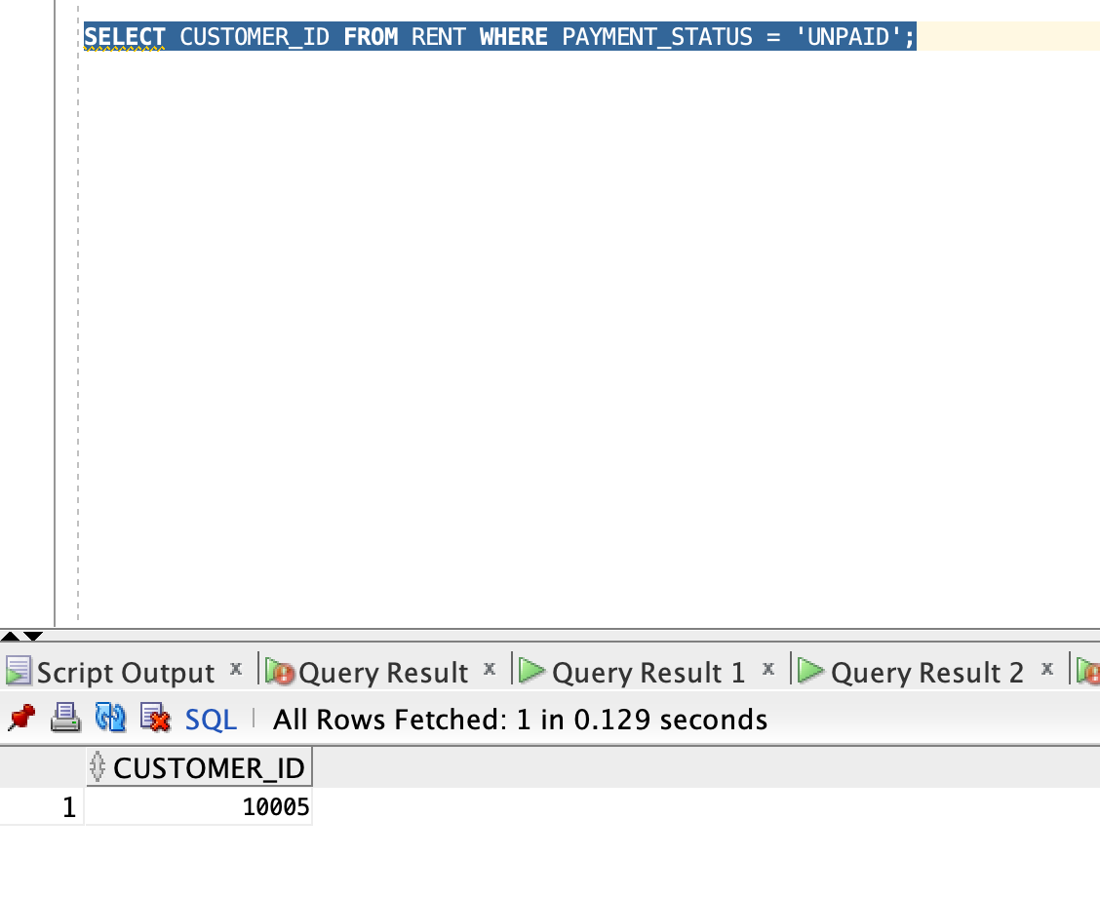
Report - 1)Customer with pending dues

Slide 11
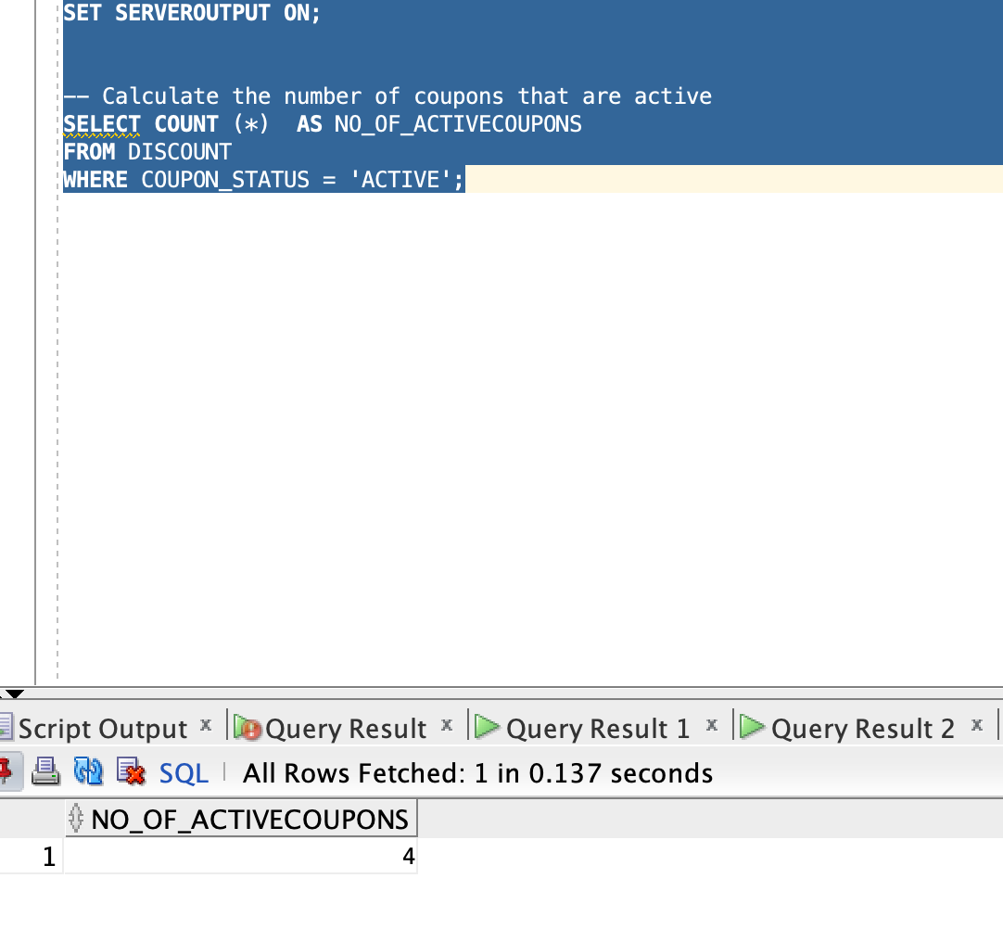
Report - 2) Finding no. of active coupons

Slide 12
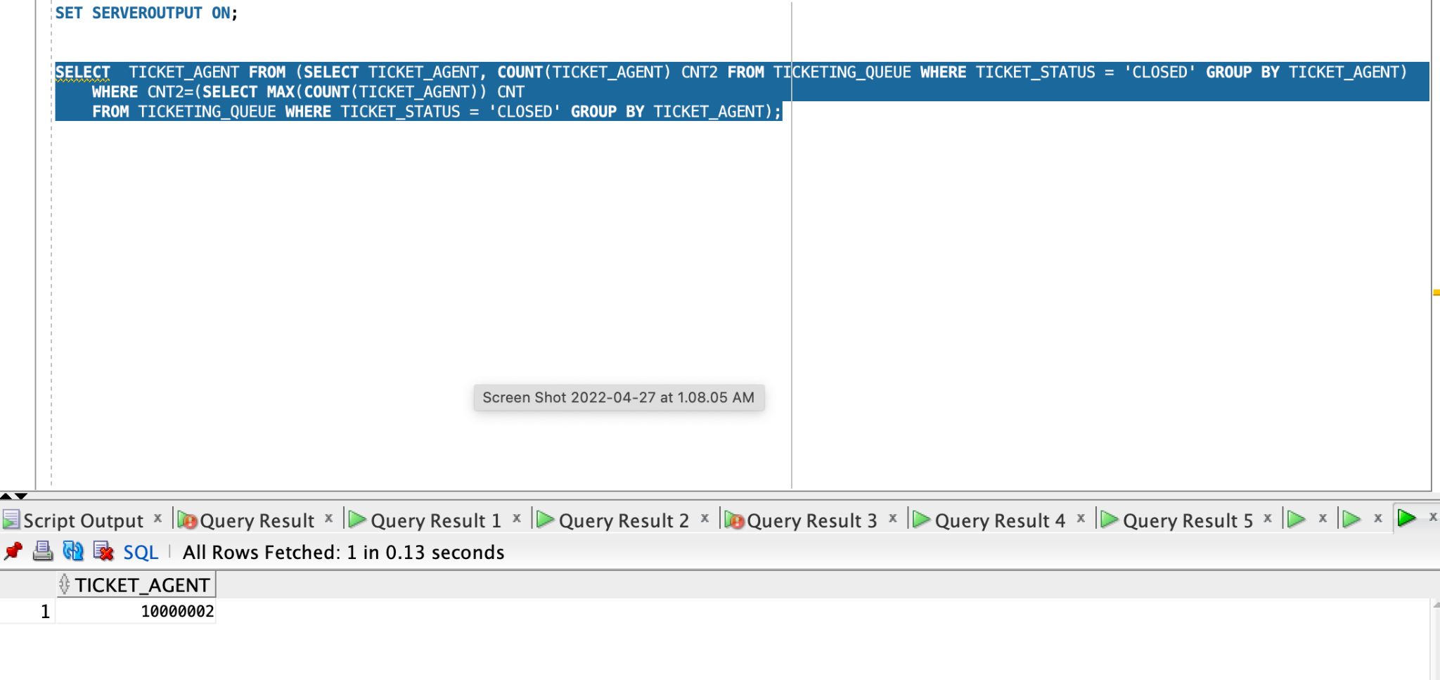
Report - 3) Ticketing agent resolving max. tickets

Slide 13
CONTRIBUTIONS
Yash Nema Customer, Ticketing, Wallet related Packages & Procedures , Function, Views
Mohit Nagpal Employee, Bike and Ride Procedure and Packages, Views, User Creation
Nirmayee Dighe Rent and Bike related Procedures and test cases of the system, Tables Creation and Views
Arjun Janardhan Membership related Procedures and test cases of the system, Packages and Views
Sushmita Maity Create, Update and Delete Procedures and Packages and Testing,Triggers
Mahendra Kaswan Membership and Wallet Tables,Views, Reports, Presentations.

Slide 14
Thank You!

